Slide 1


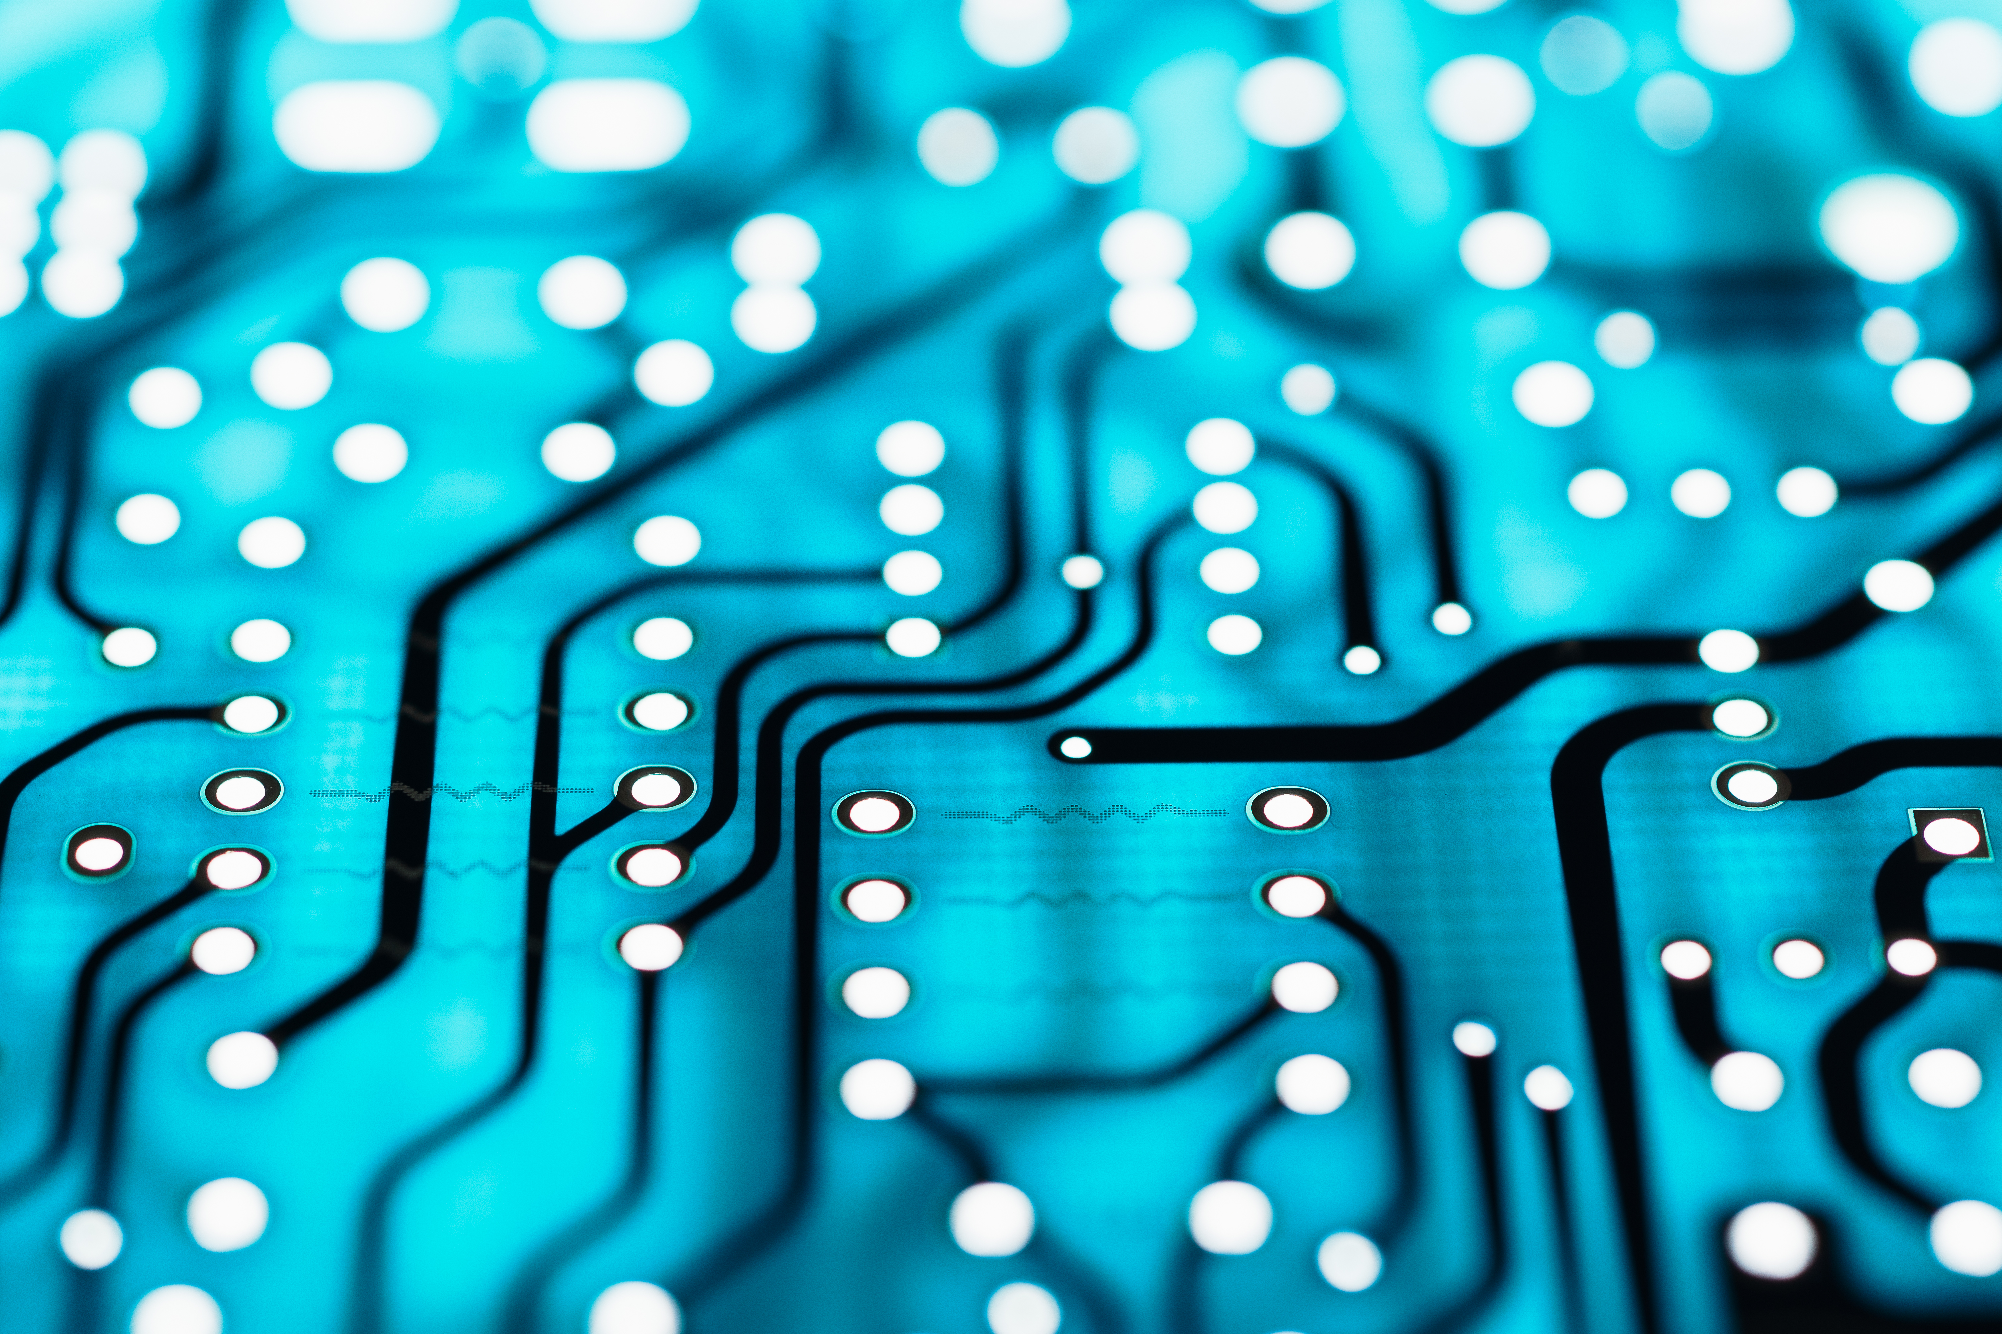
Week 1 Summary
ECE 499 Adam Dulay

Slide 2
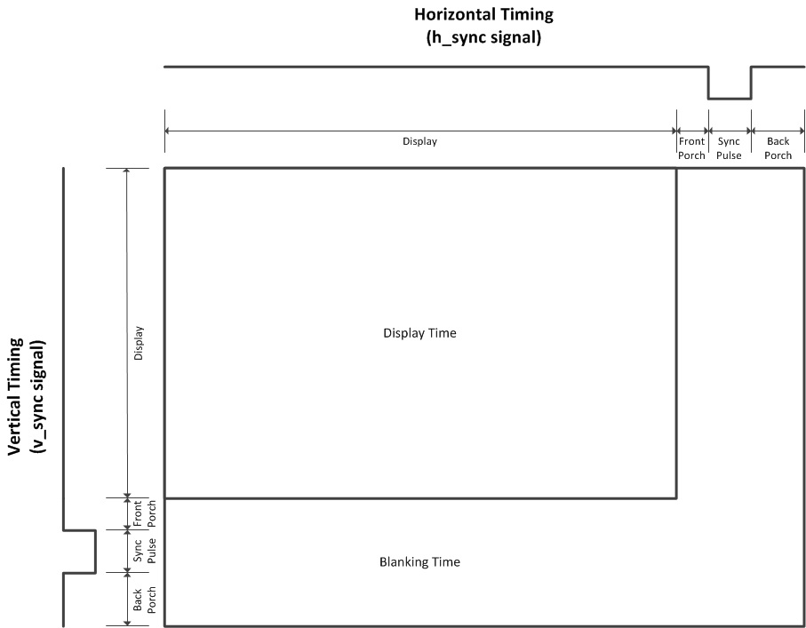
VGA Demonstration
Used DE2 to produce an 800x600 pixel resolution demo
50MHz pixel clock (using the onboard clock without scaling/division)
Created quick and dirty using a for loop
Can try it with simulated memory, but that would require more than the board can simulate

Slide 3
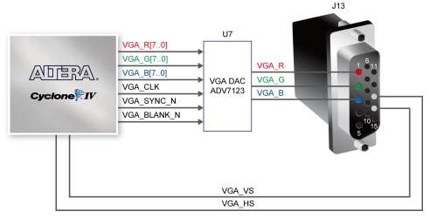
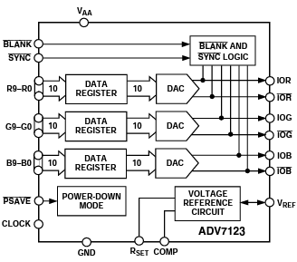
DE2 schematic and DAC unit block diagram
Sync signals come directly through from the FPGA
Color data as well as a pixel clock signal are passed through the onboard DAC unit
My monitor does not require “sync on green” mode as it has a pin for a green signal

Slide 4
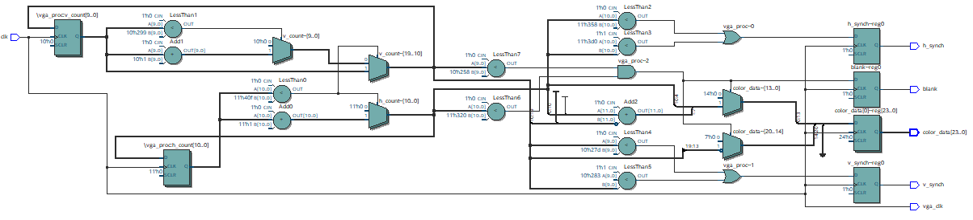
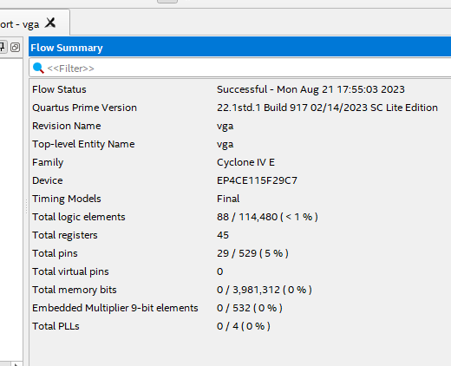
Results

Slide 5
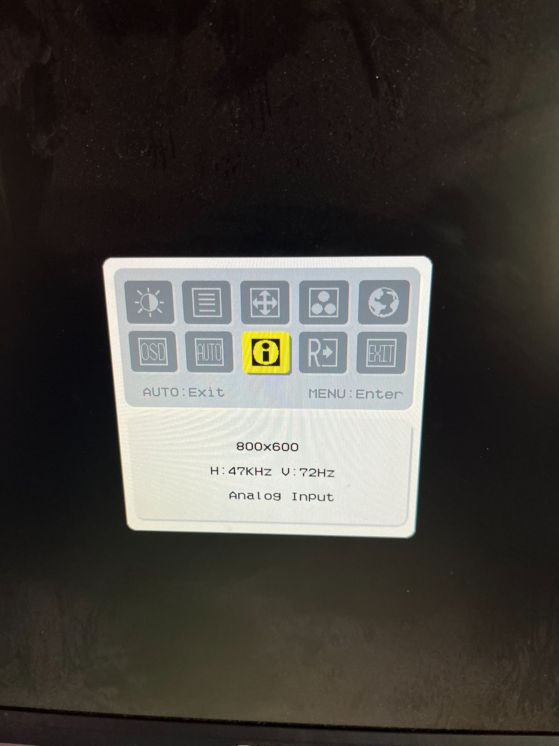
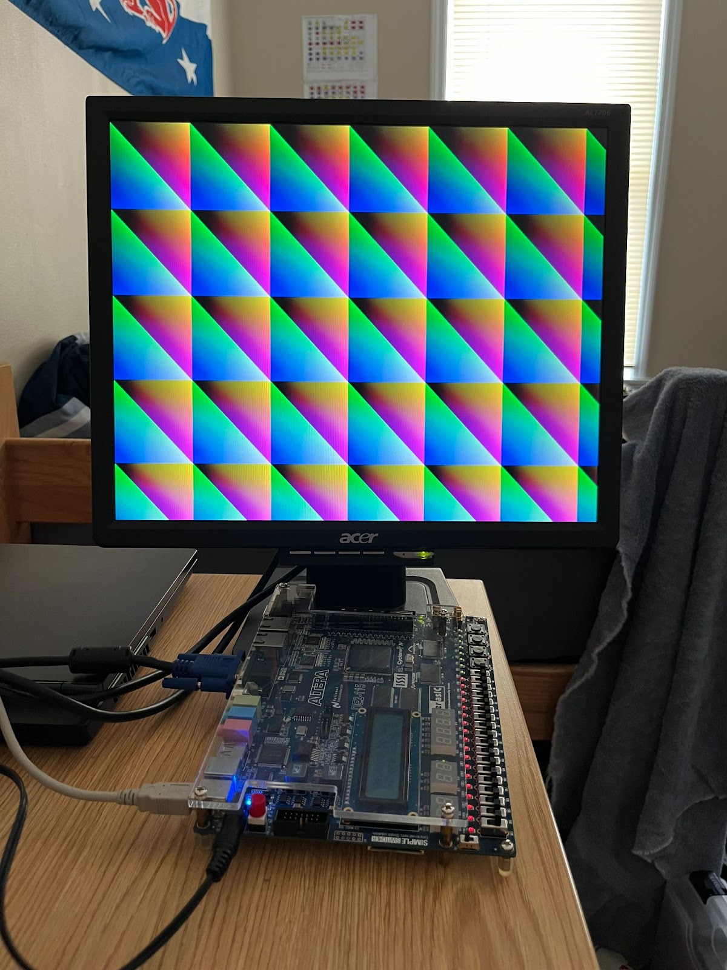
Results

Slide 6
Questions?

Slide 7
My Questions
If I were to cut the resolution down, how might I scale the clock frequency accordingly?
Are there any other solutions for VRAM other than simulated memory? Perhaps an external component?
Would you change anything about my instruction set?
Because Dr. Taha cannot meet until next week, would you advise just designing computer components instead, and worry about the instruction set later?

Slide 8
references
For general VGA timing constraints and frame section values:
http://tinyvga.com/vga-timing
DE2-115 Manual:
Pages 54 and 55
ADV7123_a Datasheet:
https://www.eecg.utoronto.ca/~tm4/ADV7123_a.pdf

